Slide 1
Smart Policing System

Slide 2
Introduction
Using video cameras for monitoring and surveillance is common in both federal agencies and private firms.
Most current video surveillance systems share one drawback: they need a human operator to constantly monitor them. Their effectiveness
An activity detection module can be devised using computer vision techniques that can detect particular activities from CCTV footage in real time.
This module can be embedded within a communication system to make a completely autonomous policing system.

Slide 3
Objectives
The Proposed system aims to fulfill the following objectives:
Overcome limitations of traditional surveillance techniques which reuqire human vigilance.
Increase effectiveness of law enforcement authority by providing comprehensive information about any activity to the nearest police control room, reducing response time as well in the process.

Slide 4
Proposed Methodology
Activity Detection Module
Processes the input received from CCTV and detects suspicious/unwanted activity
Communication
Transmits information about any unwanted activity detected to relevant police control room

Slide 5
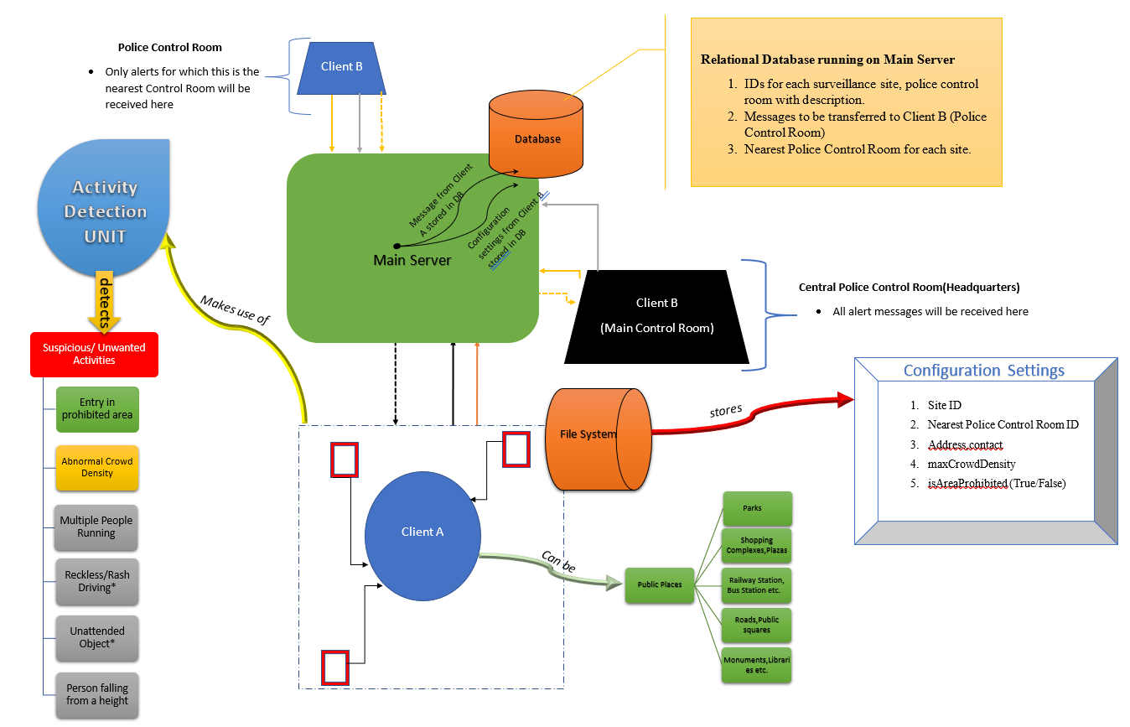
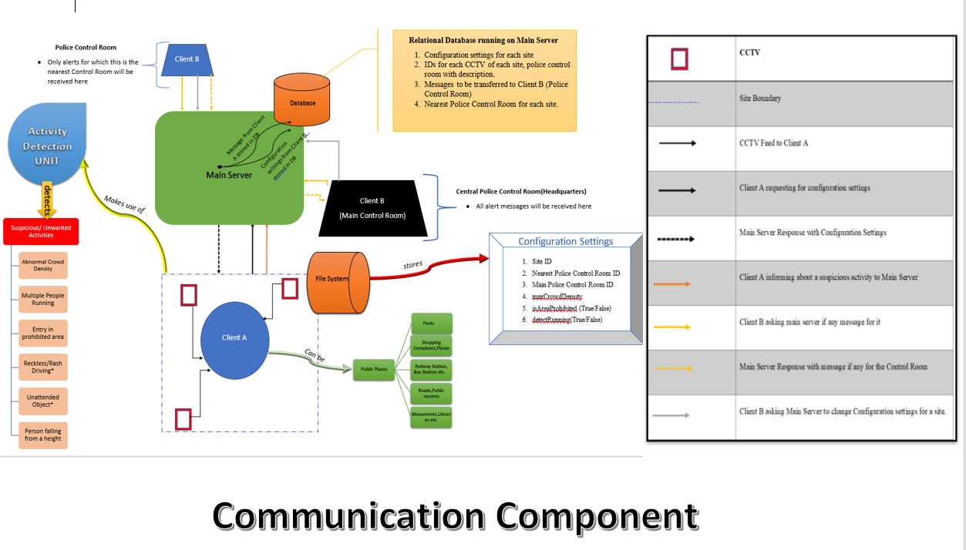
System Overview

Slide 6
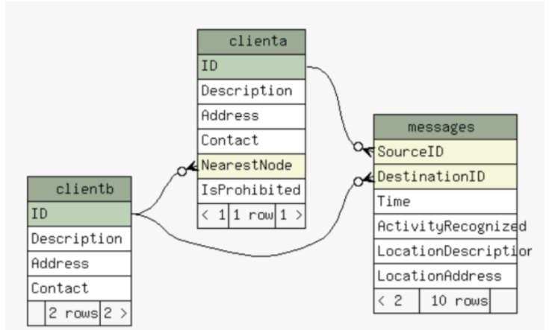
Database Design

Slide 7
Typical Workflow
The activity detection module detects any unwanted activity
Client A located at the Site prepares a message for the main server and sends it
Main server recieves the message and stores it in the database with information about the destination
All Client B check if there is any message for them ,if it is the main server responds with message
The concerned Police Control room gets the message and acts accordingly

Slide 8
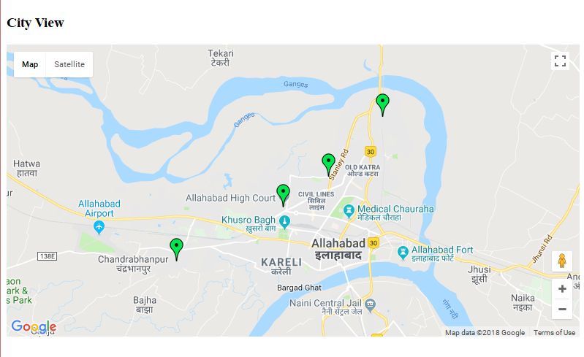
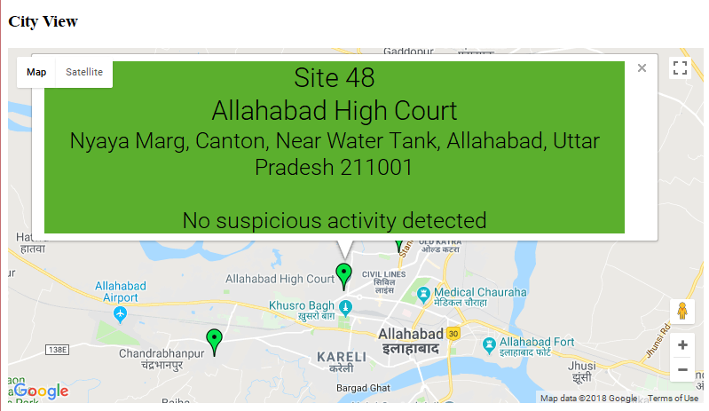
GUI – Complete System Monitoring

Slide 9
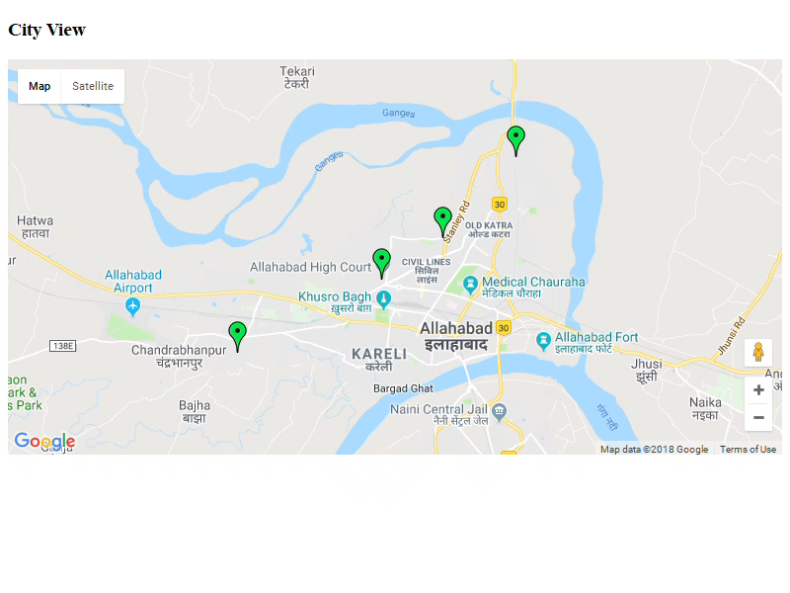

Slide 10
Activity Detection
The activity detected in this project is human detection in prohibited area
We used Histograms of oriented gradients (HOG) for human detection and background subtraction for movement detection
When moment is detected by background subtraction HOG is triggered for human detection

Slide 11


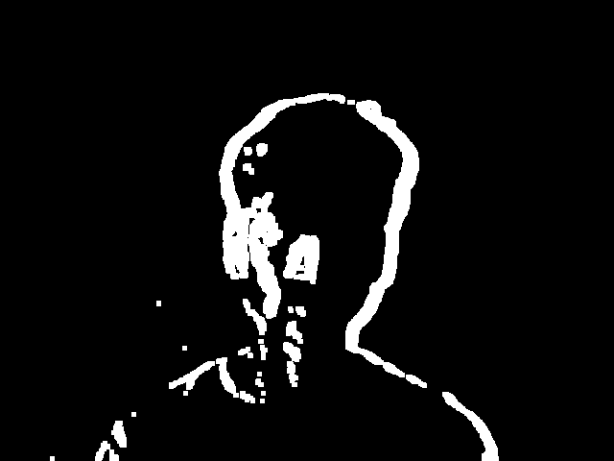
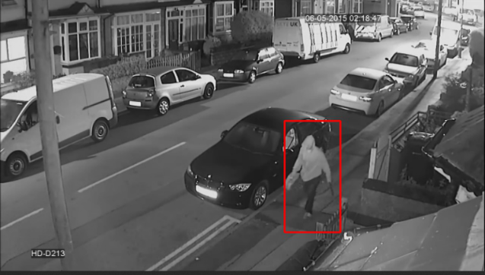
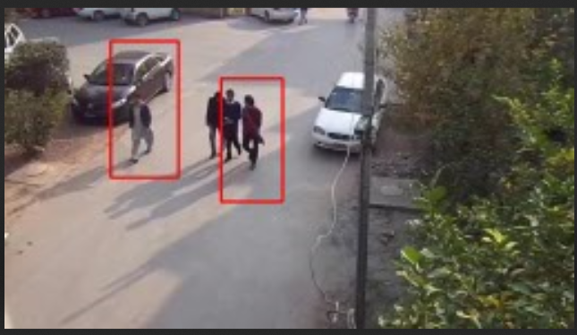
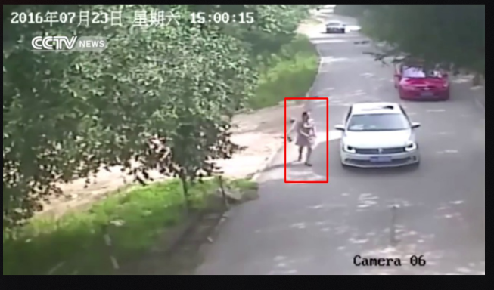
Before moment
After moment
Frame Difference
Background subtraction for moment detection
Results of Human detection after Histograms of oriented gradients(HOG)

Slide 12
Results
Activity detection (Human detection in prohibited area) is done with HOG descriptor algorithm and with some optimizations.
Thresholding Area parameter used in background subtraction also effects in processing time. If thresholding area is less false positive increases thereby increasing processing time and vice versa.
There is trade of between accuracy and speed if we want to make HOG to run in real time. The accuracy with small values of Winstride(x,y) and ScaleFactor is high with a downside of speed. With smaller values of Winstride(x,y) and ScaleFactor it has higher processing time.

Slide 13
Deployment
The system will make use of existing CCTV infrastructure.
For development purposes Flasks inbuilt server has been used. It is highly recommended to use a real web server from reliable hosting service providers like AWS Elastic Beanstalk,Microsoft Azure.
Two feasible approaches have been chalked out for deployment at surveillance site. The choice of approach depends on the type of surveillance needed on site, number of cctvs and availability of resources.

Slide 14



MAIN SERVER
MAIN SERVER
Video Processing
and communication
Video feed
Video Processing
and communication
Capture Video from different areas of the site
Single Board Computer e.g. Raspberry pi

Slide 15
References
M. Shah, O. Javed, K.Shafique,Automated Visual Surveillance in Realistic Scenarios, IEEE MultiMedia Vol. 14, Issue: 1, 2007
O. Javed, K. Shafique, and M. Shah, A Hierarchical Approach to Robust Background Subtraction Using Color and Gradient Information, Proc. IEEE Work shop on Motion and Video Computing, IEEE CS Press, 2002, pp. 22-27.
O. Javed ”Tracking across Multiple Cameras with Disjoint Views” 9th IEEE Int’l Conf. Computer Vision¡/em¿ pp. 343-357 2003.
R. Collins, A. Lipton, T. Kanade, ”Introduction to the Special Section on Video Surveillance”, IEEE Trans. Pattern Analysis and Machine Intelligence, vol. 22, no. 8, pp. 745, 2000.
Manohar Karki, Saikat Basu, Robert DiBiano, Supratik Mukhopadhyay, JerryWeltman, Malcolm Stagg, ”A symbolic framework for recognizing activities in full motion surveillance videos”, Computational Intelligence (SSCI) 2016 IEEE Symposium Series on, pp. 1-7, 2016.
N. Dalal, B. Triggs, Histograms of oriented gradients for human detection Computer Vision and Pattern Recognition, 2005. CVPR 2005. IEEE
C. Wren et al., Pfinder, Real-Time Tracking of the Human Body, IEEE Trans. Pattern Analysis and Machine Intelligence, vol. 19, no. 7, pp. 780-785.
J. Rehg, M. Loughlin, and K. Waters, Vision for a Smart Kiosk,

